Slide 1
Advanced Programming ‘C++’ {
CS1131.h
CS1131.cc
[Final Project]
< Razan AlMahdi S20106649 & Layal Ghryani S20106409 >
}
Programming Language

Slide 2
Introduction; {
introduction.h
introduction.cc
<p This program is designed to implement several new classes representing a school, and its students and courses. These classes will show the dynamic of the students, courses, and the arrays that contain them in an interactive form.>
</p>
}
Programming Language

Slide 3
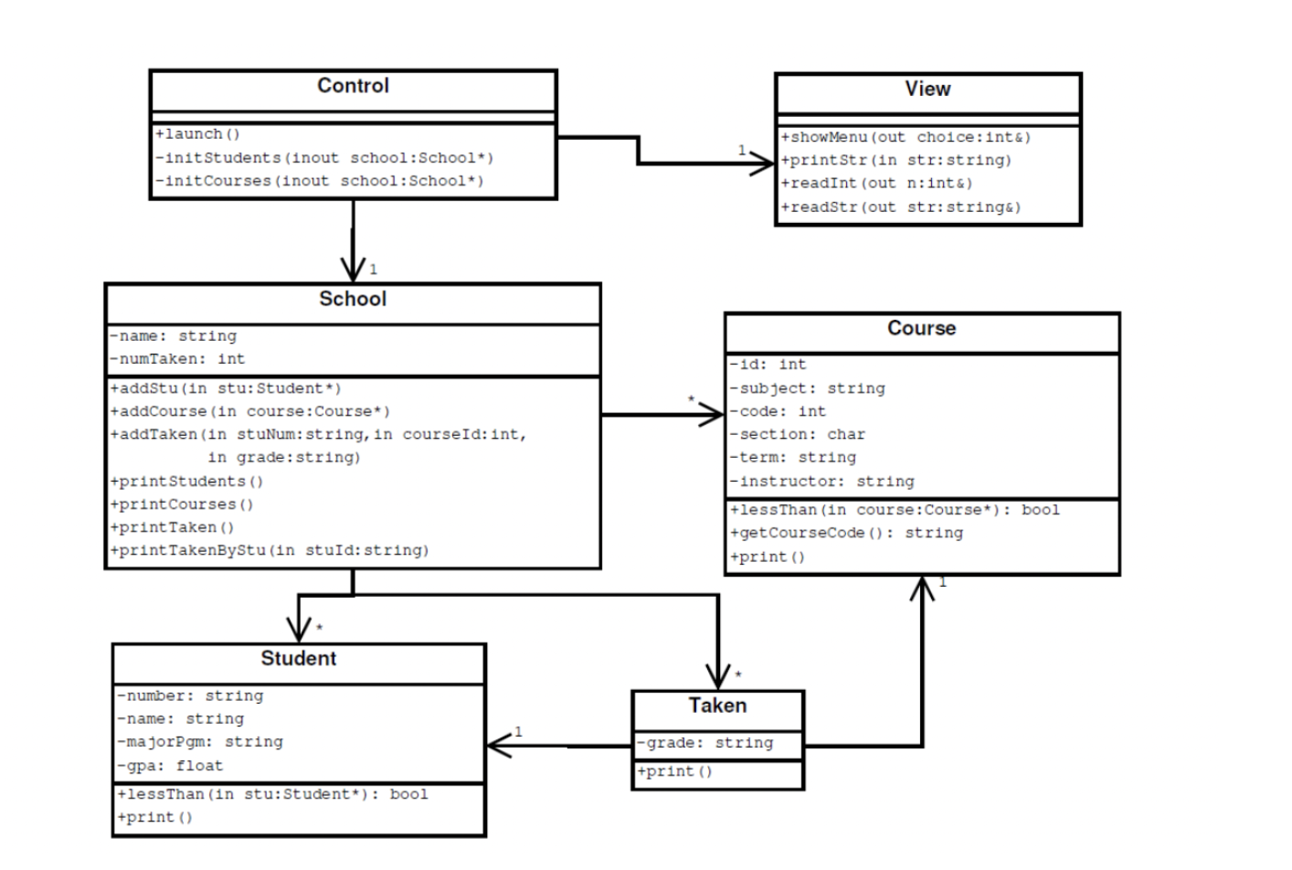

Slide 4
01 {
[Implement Student Class]
Student.h
Student.cc
< The Student class is the class where the constructs for all student information is stored. it includes the constructor, destructor, print, getter and setter functions, and a comparing boolean function that organizes the students in the array according to their names. >
}
Programming Language

Slide 5
/*the header file for the student class. this class manages the data of the
students */
#ifndef STUDENT_H
#define STUDENT_H
class Student
{
//methods
public:
Student(string="", string="", string="", float=0.0f); // overloaded constructor
~Student(); //destructor
string getName(); // name getter function
//void setName(string n); // name setter function
string getID(); //ID getter
//void setNum(string num); // id setter function
bool lessThan(const Student*); // function to compare students
void print() const;// function to print the students
// the attributes
private:
string id; //student id
string name; //student name
string major; //student major
float gpa; //student gpa
};
#endif

Slide 6
02 {
[Implement Course Class]
Course.h
Course.cc
< The Course class contains all the constructs of all courses. It has a constructor, destructor, print, getter and setter function, And comparing function that organizes the courses according to their subject, then code, then section. >
}
Programming Language

Slide 7
/*header file for course class that has the functions needed to manage
all courses*/
#ifndef COURSE_H
#define COURSE_H
class Course
{
// methods
public:
Course(int=0, string="", int=0, char='\0', string="",string=""); //overloaded constructor
~Course(); // destructor
bool lessThan(Course*); // comparing function
string getCourseCode(); // couse code getter function
int getId(); // id getter function
void print(); // print function
// attributes
private:
int id; // course id
string subject; // course subject
int code; // course code
char section; // course section
string term; // course term
string instructor; // course instructor
};
#endif

Slide 8
03 {
[Implement Taken Class]
Taken.h
Taken.cc
< The taken class that refers to both course and student class. It groups up both of them by using getter functions, and constructing them into a structure of its own for the taken class.>
}
Programming Language

Slide 9
/* header file for the taken class. this class combines student and course class*/
#ifndef TAKEN_H
#define TAKEN_H
#include "Course.h"
#include "Student.h"
class Taken
{
// methods
public:
Taken(Student*, Course*, string=""); // overloaded constructor
Student* getStudent(); // getter student function
Course* getCourse(); // getter course function
void print(); // print taken
// attributes
private:
string grade; // grade
Student* stu; // student object
Course* course; // course object
};
#endif

Slide 10
04 {
[Implement DynArray Class]
DynArray.h
DynArray.cc
< The DynArray class relates to the student class. It is used to create a dynamic array, create student objects and add them, find student objects within the array, and eventually print them. >
}
Programming Language

Slide 11
/*header file for dynamic array that creates an array for all students and
their information*/
#ifndef DYNARRAY_H
#define DYNARRAY_H
#define MAX_ARR 64
#include "Student.h"
class DynArray{
public:
//methods
DynArray();//default constructor
~DynArray();//destructor
void add(Student*);//add student to the array
bool find(string, Student**); //find student by id in the array
void print(); // print the array
private:
//attributes
Student** studentArray; // array of type student
int size; // size of array
};
#endif

Slide 12
05 {
[Implement StatArray Class]
StatArray.h
StatArray.cc
< The StatArray class relates to the course class. It is used to create a dynamic array, create course objects and add them, find course objects within the array, and eventually print them. >
}
Programming Language

Slide 13
/*header file for static array class that puts all courses into an array
and then prints them*/
#ifndef STATARRAY_H
#define STATARRAY_H
#define MAX_ARR 64
#include "Course.h"
//collection class made to statically allocated store object pointers of course elements
class StatArray
{
// methods
public:
StatArray();// default constructor
~StatArray();// destructor
void add(Course*);// function to add course to array
bool find(int ,Course**); // function to find a student id related to course
void print();// print function
private:
Course* courseList[MAX_ARR];// array object of type course
int size;// size of array
};
#endif

Slide 14
06 {
[Implement School Class]
School.h
School.cc
< The School class relates to Course, Student, and Taken classes. It enables us to add student objects, course objects, and taken objects to the dynamic arrays, and then print them by specification according to the option chosen in the View + Control class. >
}
Programming Language

Slide 15
/*header file for School class. this class manages student, course, and Taken
class and has the functions that enable us to add student, course, taken, and
print them*/
#ifndef SCHOOL_H
#define SCHOOL_H
#define MAX_SIZE 64
#include "Course.h"
#include "Student.h"
#include "Taken.h"
#include "DynArray.h"
#include "StatArray.h"
class School
{
// methods
public:
School(string=""); // constructor
~School(); // destructor
void addStudent(Student*); // function to add student to array
void addCourse(Course*); // function to add course to array
void addTaken(string, int, string); // function to add taken to array
void printStudents(); // funcrion to print students
void printCourses(); // function to print courses
void printTaken(); // function to print all taken courses
void printTakenByStudent(string); // function to print taken courses by a student
// attributes
private:
string name; // name of school
DynArray collectionOfStudents; // student collection object of type dynarray
StatArray collectionOfCourses; // course collection object of type statarray
Taken* collectionOfTaken[MAX_SIZE]; // taken collection object of type taken
int numOfTaken; // number of courses taken
};
#endif

Slide 16
07 {
[Implement Control Class]
Control.h
Control.cc
< The Control class is the backbone of the program. It contains all of the student and course objects, and the information for each object, and launches the entire program. It also has a switch function that checks the input imported from the View class, and based on it, it will connect to the School class functions. >
}
Programming Language

Slide 17
/*the source code file for the header of control*/
#ifndef CONTROL_H
#define CONTROL_H
#include "School.h"
#include "View.h"
class Control
{
public:
Control(); //default constructor
void launch(); //launching function for the entire program
private:
void startStudents(School*); //function to initialize all students
void startCourses(School*); //function to initialize all courses
School school; //object of school class
View view; //object of view class
};
#endif

Slide 18
08 {
[View class ]
View.h
View.cc
< The View class is a class with no private members. Its purpose is to output the menu of options, and prompt the user for input. Then, it passes the input on to the Control class to activate the switch, and so on.>
}
Programming Language

Slide 19
/*header file to view class. this file shows the menu to the user*/
#ifndef VIEW_H
#define VIEW_H
class View
{
// all members are public members in this class
public:
void showMenu(int&); // function to output menu. int passed by reference
void printString(string); //function to get input from user
void readInt(int&); //function to take selected choice by user for switch
void readString(string&); //function to read input given by user
};
#endif

Slide 20
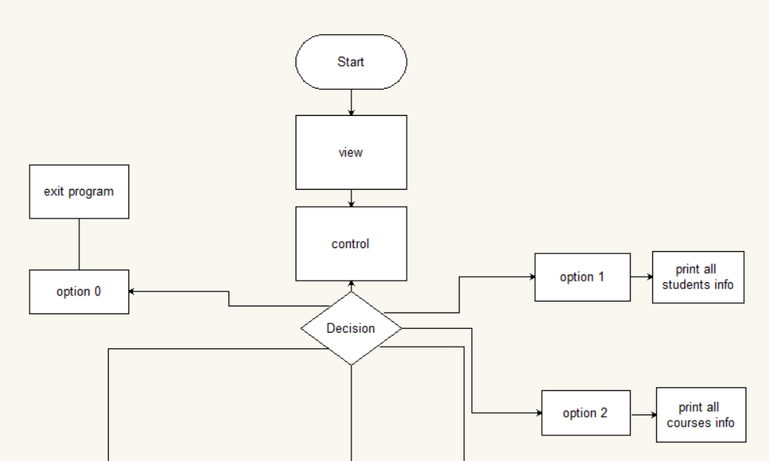
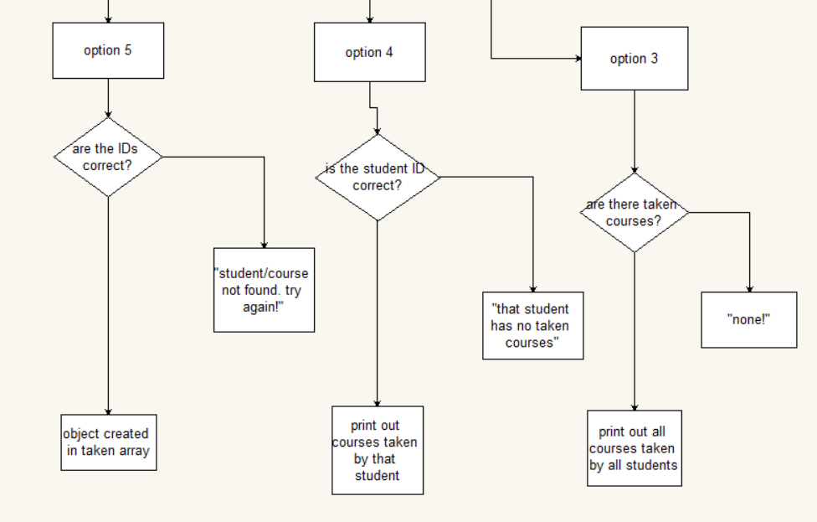

Slide 21
Conclusion {
Conclusion.h
Conclusion.cc
< This 1 month project was a rollercoaster filled with tears and happiness. Teamwork was assessed extremely as we had to put both of our patience and knowledge and understanding skills to the test. It was fun to an extent. We really struggled and in the end we achieved what we wanted and the program works. To Future programmers even though this took longer time to create we learned and discovered new skills that we didn't know about and We personally thought we wouldn't reach to the end of this creation project journey and here we are.
Thank you so much Dr.Akila for this eye opening project >
}
Programming Language

